Slide 1

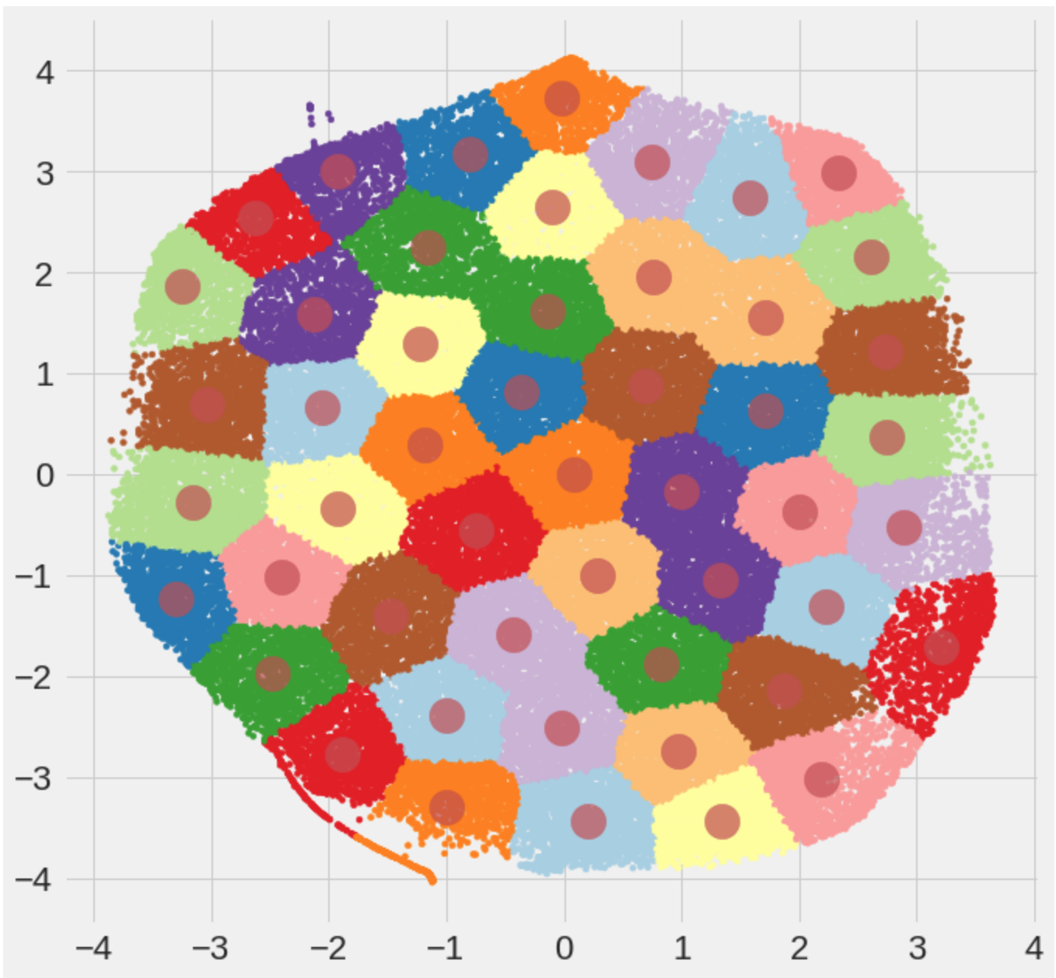
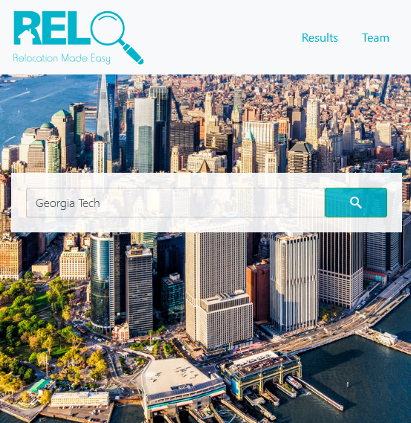
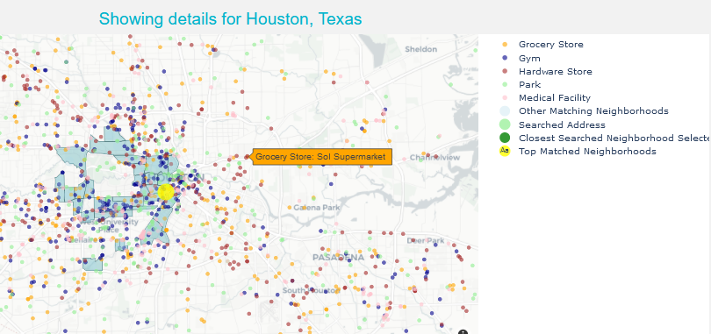
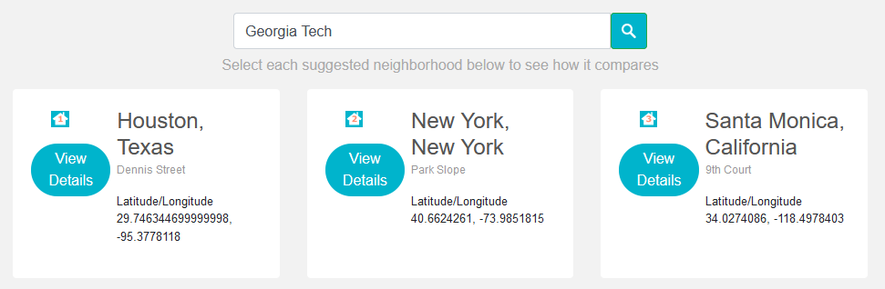
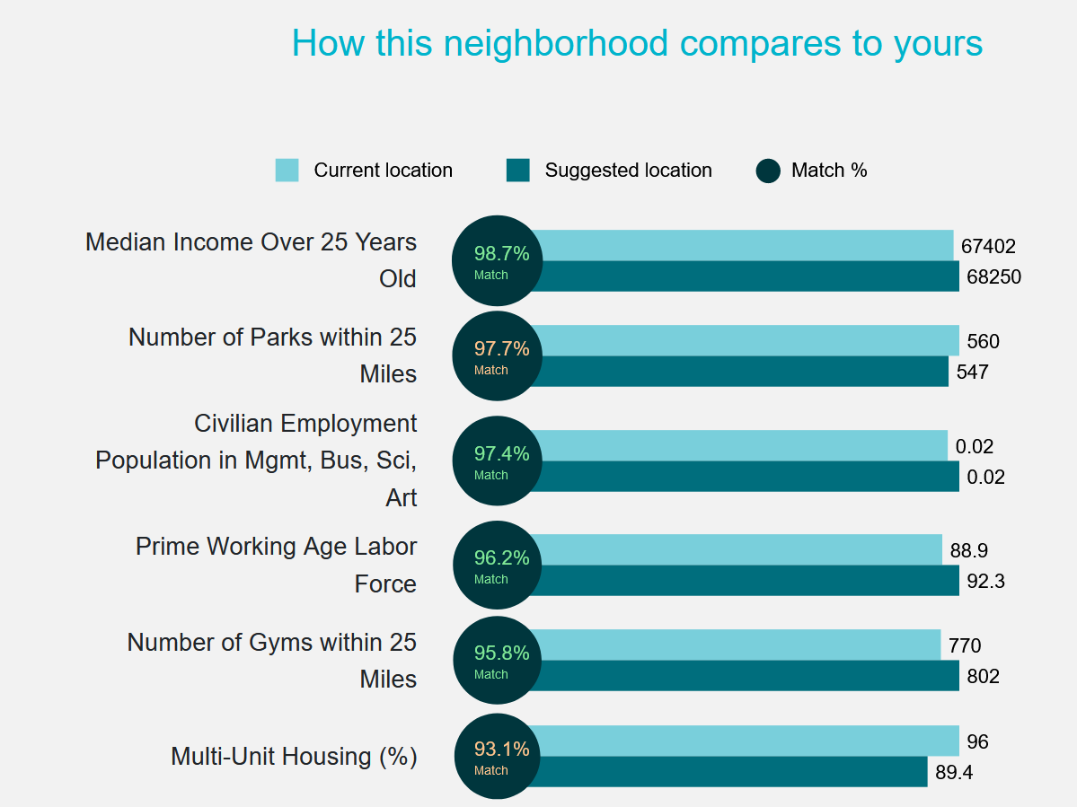
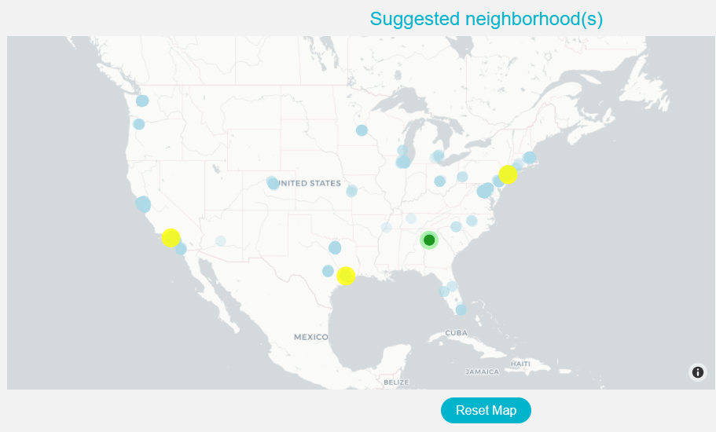
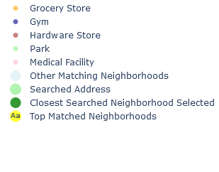
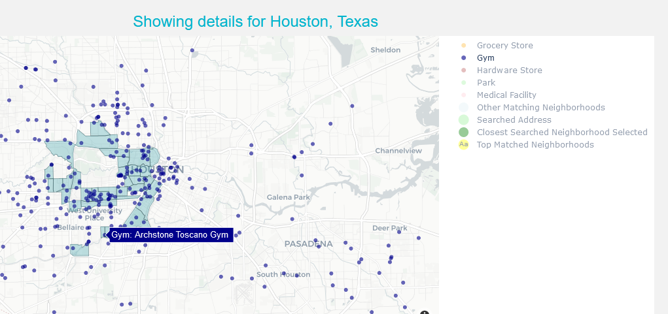

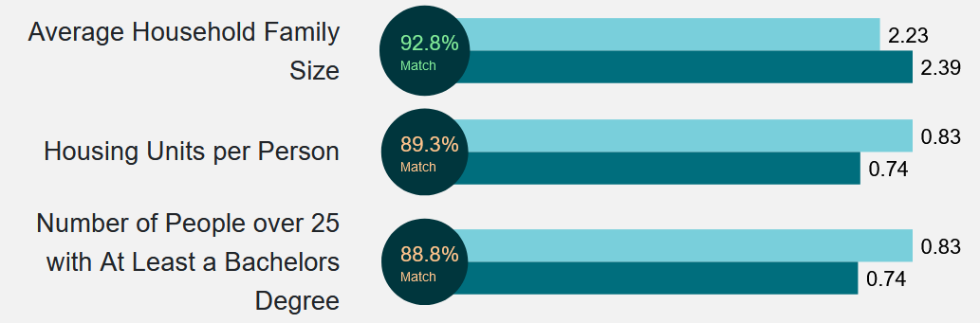
A Clustering-Based Approach Incorporating Census and Amenities Data to Find the Best Neighborhood to Live
Amelia Bell, Michael Bodie, Aravinda Dassanayake, Joseph Janicki, Riesling Meyer, and Nathan Smooha
Motivation
Census Data
Amenities Data
According to Census data, relocation in America is at its lowest rate on record¹. This is concerning because the lack of people moving for work could negatively impact the economy². Still, trying to find the right place to live can be difficult.
Current tools do not consider nuances between neighborhoods while simultaneously offering personalized suggestions. Also, they lack interactive visualizations and data on essential services, like grocery stores. “Top City” lists are too broad and impersonal³, and people may not know what factors are important to them.
So, our team developed RELO, a visualization tool that helps people find the right neighborhood used Census and amentities data. It is an interactive application that provides users with useful and personalized information on new areas based on ones they already know and love. RELO will give people the confidence to relocate when the might have been hesitant to before.
We used Census data from the 5-year American Community Survey Responses for 2018, which was downloaded from data.census.gov
We pulled data on grocery stores, parks, hardware stores, gyms, and medical care facilities from Foursquare’s Places API, leveraging zip codes from simplemaps.com/data/us-zips
Get Data from API
Profile Data
Remove Unnecessary Columns
Remove High Null Rows
Transform Columns to be % of Pop
Profile Data
Load States
Load State Zip Codes
Call Foursquare API
Capture Venues
More Zip Codes in St?
Additional States?
no
Merge Datasets
yes
no
yes
Remove Unnecessary Columns
Dataset for Viz
Impute Nulls
Normalize and Standardize Data
Clustering Dataset
State Dataset
Amenities Dataset
Original Census Dataset
# Columns 1,316
# Rows 74,001
Size on Disk 1,200 MB
Cleaned Census Dataset
# Columns 28
# Rows 73,056
Size on Disk 20.5 MB
Original Amenities Dataset
# Columns 8
# Rows 275,641
Size on Disk 32 MB
Cleaned Amenities Dataset
# Columns 11
# Rows 230,157
Size on Disk 30.7 MB
The geometries for Census tracts (e.g. shape files) were downloaded from github.com/loganpowell/census-geojson/tree/master/GeoJSON/500k/2018
We identified the amenities within each Census tract, as well as those within 2, 5, 10, 25, and 50 miles of the tract center. The amenities data was weighted and joined to the Census data. Each amenity's count of entities within 25 miles of the tract centers were used as features in our clustering dataset, which was based on their data distributions.
Approaches
Experiments and Results
Figure 1
Census Data
Amenities Data
Census Shapes
RELO is an interactive web application. Users input an address of a location they like and our tool finds the closest Census tract center. Then, RELO showcases all Census tracts (i.e., neighborhood proxies) that are similar to the users’ inputs, and it displays the 3 closest tracts by Euclidean distance in the feature space. Similar tracts belong to the same cluster, and a KMeans model with 50 clusters generated the groupings. Users can click any one of the 3 featured locations to zoom in to see its amenities.
These new approach effectively solves our problem by providing users recommendations based on their input. Users can view suggestions across the US and can click to see more information about specific locations. This gives users confidence in choosing a new neighborhood.
Is the data clusterable? We ran a statistical test that used the Hopkins statistic, which measures the probability that a dataset was generated by a uniform distribution⁴. With a threshold of 0.5, the Hopkins statistic returned a result of 0.008, so we rejected the null hypothesis in favor of the alternative that our data contained clusters and was not uniformly distributed.
How many clusters? To choose the correct number of clusters, we compared relevant internal validity measures (Fig. 1) with the load times of our visualization tool (Fig. 2). Ultimately, we selected 50 clusters for all the algorithms we tested in order to improve the user experience of our tool.
Which algorithm to use? We evaluated the Silhouette, Calinski-Harabasz, and Davies-Bouldin internal validity measures to determine the best clustering method with 50 clusters for our dataset (Fig. 3). Based on the results, the KMeans algorithm was chosen to be the final model for our tool (Fig. 4)
 | Silhouette | Calinski-Harabasz | Davies-Bouldin | "Elbow Method" | Gap Statistic
KMeans | 3 (.40) | 50 (72462.59) | 15 or 39 (0.77) | 10 (51231.32) | 34 (0.47)
Mini-Batch KMeans | 3 (.39) | 50 (69040.65) | 7 (0.78) | 10 (55459.62) | 6 (0.35)
Spectral | 48 (.322) | 50 (64344.15) | 2 (0.61)
Ward | 2 (.35) | 50 (58761.53) | 4 (0.87)
BIRCH | 3 (.35) | 50 (57272.38) | 4 (0.86)
Clustering Code
Combine Amenities with Geographies
Clustering Output
User
Website Landing Page
Plotly Fig Builder Code
Build Map Figures
Figure 2
 | 15 clusters ~5,000 members per cluster |  | 50 clusters ~1,400 members per cluster
Sample | Time (in sec.) from app start to server ready | Time (in sec.) from search of "Atlanta, GA" to results page loaded. | Time (in sec.) from app start to server ready | Time (in sec.) from search of "Atlanta, GA" to results page loaded.
1 | 12.74 | 31.54 | 10.94 | 7.19
2 | 12.77 | 31.6 | 10.74 | 6.97
3 | 12.64 | 29.84 | 10.38 | 6.27
4 | 12.79 | 33.32 | 10.5 | 6.98
5 | 12.65 | 29.99 | 10.39 | 7.28
Mean | 12.7 | 31.3 | 10.6 | 6.9
SD | 0.1 | 1.4 | 0.2 | 0.4
Website Results Page
Figure 4
What are the features that make each cluster unique? We calculated the variance of means between clusters within each feature and determined the top ones. These were the amenities within 25 miles (std devs ~.2), percent of population that is white (single race) (std dev .200), and % of housing that is multi-unit (std dev .185) .
How does this compare to other methods? This clustering and ranking approach represents a first step in providing personalized recommendations on places to live, which is not a feature offered by other tools.
Welcome Search Screen
Search Results
Interactivity (Click on Recommendation)
Highlights all neighborhoods in a cluster and features the 3 most similar
Map zooms to selection
See how the selected recommendation compares to the original search
Figure 3
Filter amenities on map
 | Silhouette | Calinski-Harabasz | Davies-Bouldin
KMeans | 0.34 | 72462.59 | 0.79
Mini-Batch KMeans | 0.33 | 69040.65 | 0.83
Spectral | 0.32 | 64344.15 | 0.76
Ward | 0.27 | 58761.53 | 0.91
BIRCH | 0.26 | 57272.38 | 0.93
2D Visualization of the final model's clustering output and cluster centers
¹ Tavernise, S. (2019, November 20). Frozen in Place: Americans Are Moving at the Lowest Rate on Record. The New York Times. https://www.nytimes.com/2019/11/20/us/american-workers-moving-states-.html
² Kopf, D. (2018, November 30). Americans are moving less than ever, and it’s bad for the economy. Quartz. https://qz.com/1480835/the-share-of-americans-moving-hit-a-record-low/
³ Okulicz-Kozaryn, A. (2011). City Life: Rankings (Livability) Versus Perceptions (Satisfaction). Social Indicators Research, 110, 433-451. https://doi.org/10.1007/s11205-011-9939-x
⁴ Lawson, R., & Jurs, P. (1990). New index for clustering tendency and its application to chemical problems. Journal of Chemical Information and Computer Sciences, 30(1), 36-41. https://doi.org/10.1021/ci00065a010
Notes:
Presentation delivery:
5% Finished on time?
5% Spoke clearly and at a good pace?
Poster Design:
5% Layout/organization (Clear headings? Easy to follow?)
5% Use of text (Succinct or verbose?)
5% Use of graphics (Are they relevant? Do they help you better understand the project's approaches and ideas?)
5% Legibility (Is the text and figures too small?)
5% Grammar and spelling

